Slide 1
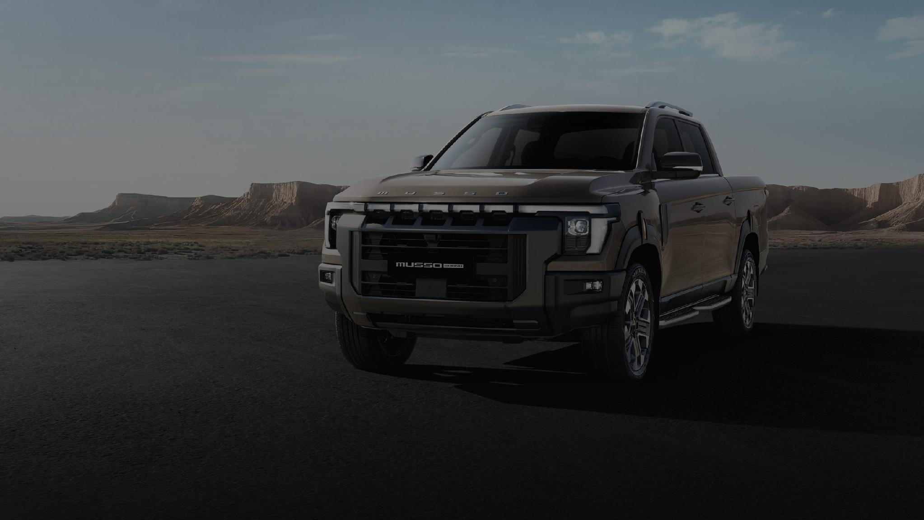


AN ALTERNATE APPROACH · PROPOSAL
MICROSITE QUICK-START
Live before the first cars land
A bilingual, image-led microsite that captures interest from day one, while the full website is built without time pressure.
PREPARED BY WORX BY GLIMPSE · JULY 2026 · MARWAN@WORXBYGLIMPSE.COM

Slide 2
WHY THIS APPROACH
THE MODELS LAND IN AUGUST.
The first KGM vehicles arrive in the UAE in a matter of weeks.
A full website, done properly, takes months considering design system, CMS, CRM, bilingual QA. Rushing it to meet the cars would waste everything the main proposal gets right.
The quick-start closes the gap: a premium bilingual microsite, live before the first delivery, meanwhile the full website is built calmly alongside it.
LIVE BEFORE THE CARS ARRIVE
Launch marketing has a premium destination from day one instead of a “coming soon” page.
LEADS FROM DAY ONE
Every early enquiry is captured and emailed straight to your sales team
AUGUST 2026
FIRST VEHICLES IN THE UAE
THE FULL WEBSITE, WITHOUT THE RUSH
The main site is built properly in parallel
You benefit from a further 10% discount if you take this path (see commercials).
WORX BY GLIMPSE — KGM UAE MICROSITE QUICK-START
QUICK-START

Slide 3
WHAT WE BUILD
ONE PAGE. EVERYTHING THAT MATTERS.
A single premium scroll, bilingual, image-led, engineered for one outcome: a registered lead.
HERO
Cinematic arrival. One message: KGM is in the UAE.
THE MODELS
Image-led lineup: names, hero shots, key numbers only.
GALLERY
Full-bleed brand imagery. No walls of text.
SHOWROOMS
Locations, hours, live map & directions.
REGISTER INTEREST
A 30-second bilingual form, straight to sales.
ON EVERY SCREEN
The always-there layer
EN | AR SWITCHER
WHATSAPP CLICK-TO-CHAT
REGISTER-INTEREST CTA
PDPL PRIVACY & CONSENT
Deliberately left out: CMS, CRM integration, news, FAQ, warranty content, seven model detail pages. That scope belongs to the full website, priced and phased in the main proposal.
WORX BY GLIMPSE — KGM UAE MICROSITE QUICK-START
QUICK-START

Slide 4
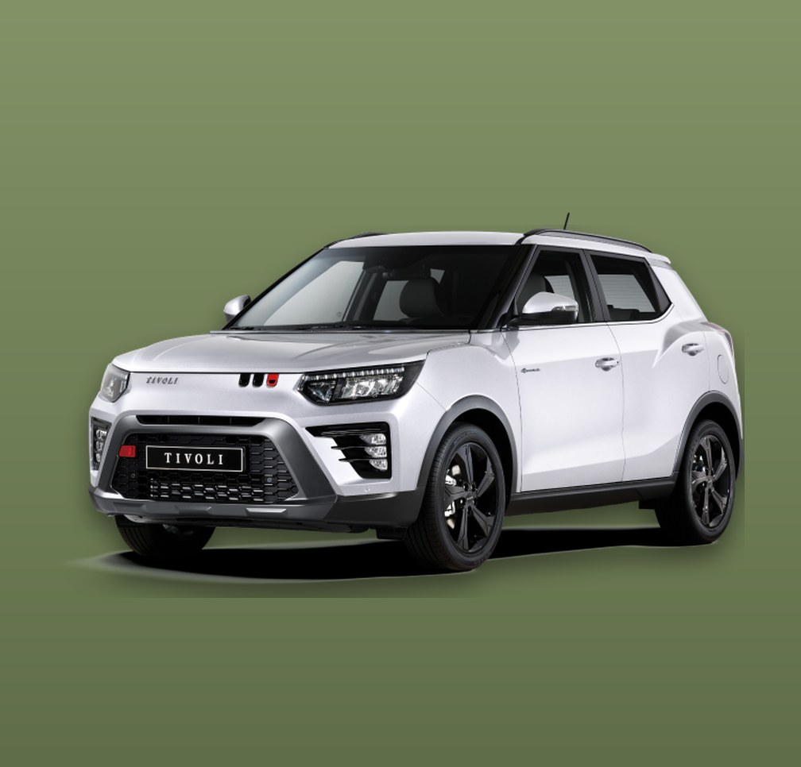
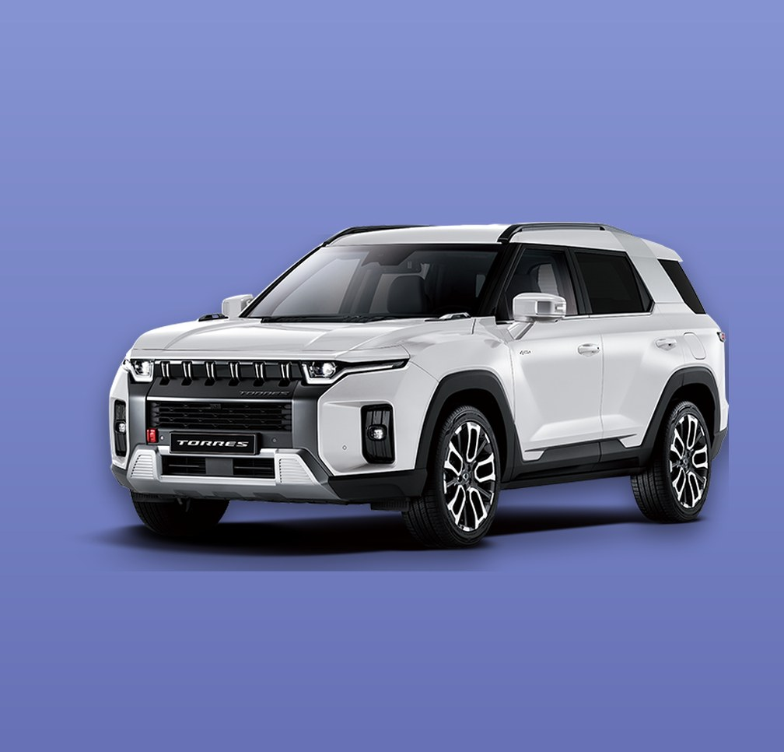
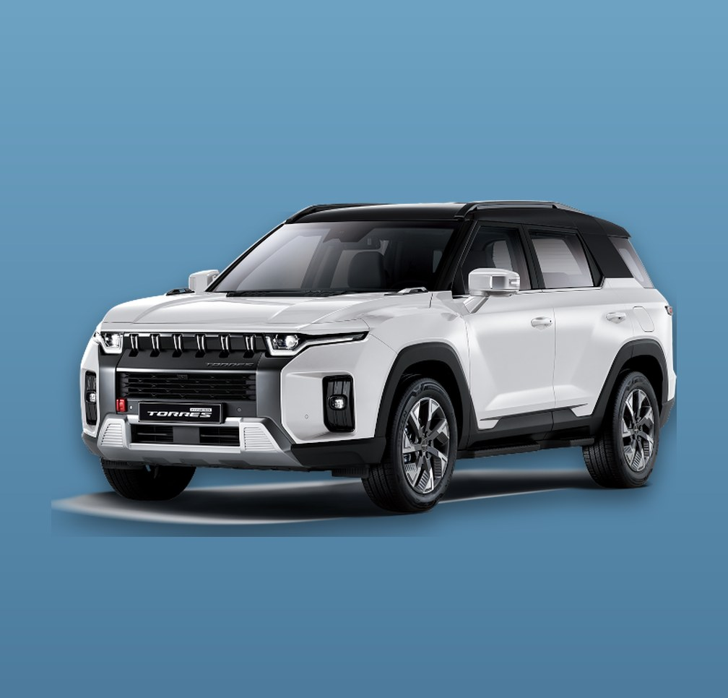

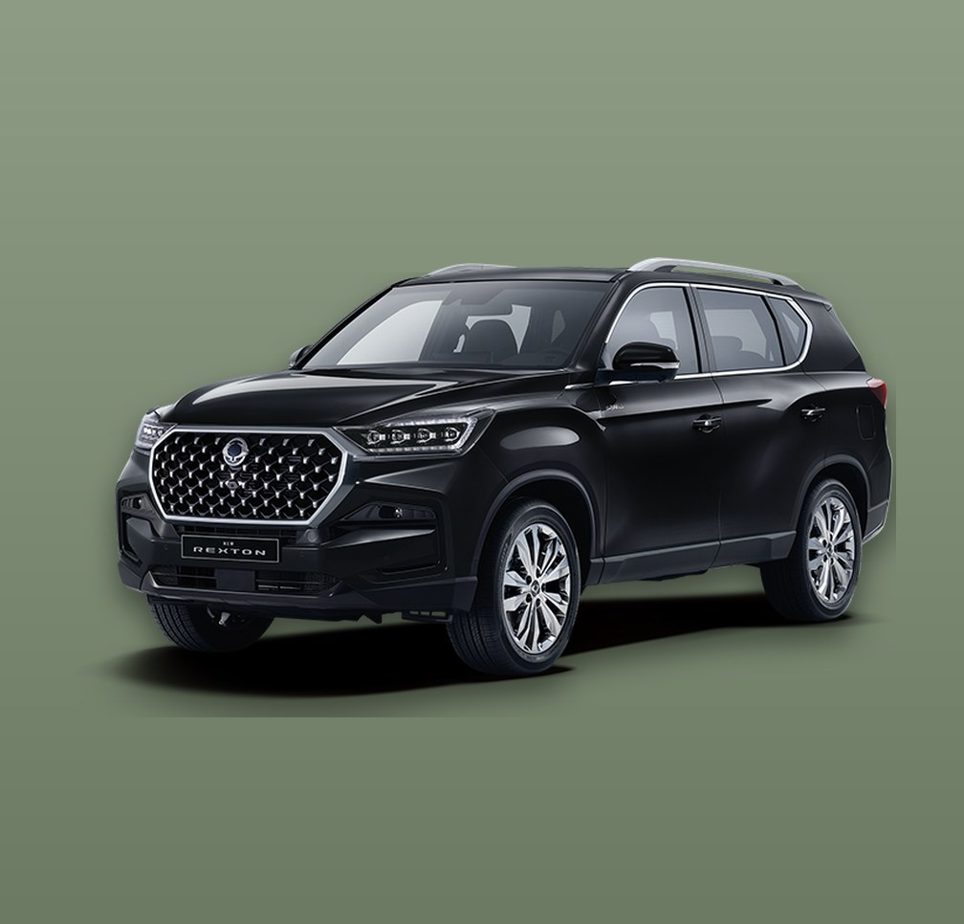


THE USER JOURNEY
A SHORT SCROLL THAT SELLS
ARRIVE
One cinematic screen. The car, the name, one line of copy.
EXPLORE
Swipe through the models’ aesthetic shots, three key numbers each.
TRUST
Gallery and showrooms. KGM is really here and just a few minutes away.
REGISTER
Name, phone, model. Sales takes over.
Brief but engaging — beautiful imagery, short lines, one clear action. Built mobile-first for launch-campaign traffic.
TIVOLI
TORRES
TORRES HYBRID
ACTYON
REXTON
MUSSO
MUSSO EV
THE LINEUP, SHOWCASED WITH OFFICIAL IMAGERY
WHICHEVER MODELS ARRIVE FIRST LEAD THE PAGE
WORX BY GLIMPSE — KGM UAE MICROSITE QUICK-START
QUICK-START

Slide 5
BILINGUAL EN / AR
ARABIC IS A FIRST-CLASS CITIZEN
TRUE MIRRORING
Layout, navigation, forms and sliders flip, not just the text.
ARABIC TYPOGRAPHY
Cairo typeface, tuned line-height, designed for Arabic.
HUMAN TRANSLATION
All microsite copy professionally localised EN→AR.
ENGLISH - LTR
ARABIC - RTL, FULLY MIRRORED
Both languages ship together on day one.
The microsite launches EN + AR simultaneously.
SMART SWITCHING
EN | AR toggle + hreflang, so Google serves each audience the right version.
WORX BY GLIMPSE — KGM UAE MICROSITE QUICK-START
QUICK-START

Slide 6
LEAD CAPTURE
FROM INTEREST TO INBOX IN SECONDS
FILL
Name · phone · emirate · model of interest. 30 seconds, in English or Arabic.
VALIDATE
Field validation, spam & bot protection, PDPL consent recorded.
NOTIFY
Instant email to your salesperson containing every detail, ready to dial.
FOLLOW UP
Sales calls back while the interest is hot.
WHATSAPP CLICK-TO-CHAT
For buyers who would rather message than fill a form.
GA4 EVENTS
Every submission is tracked so marketing sees exactly which campaign produced it.
CRM-READY
Leads are structured and exportable, so we can import them cleanly into Zoho or CRAMS when the full website lands.
NO LEAD LOST
Submissions are also logged in a running sheet, the inbox is never the only copy.
WORX BY GLIMPSE — KGM UAE MICROSITE QUICK-START
QUICK-START

Slide 7
DELIVERY
LIVE IN THREE WEEKS
WEEK 1
WEEK 2
WEEK 3
DESIGN & CONTENT
Design system adapted from the main proposal · EN copy written · AR translation starts
OUTCOME
A signed-off design, both languages in hand
THE BUILD
Bilingual build EN + AR · interest form & email routing · imagery, models & showrooms in place
OUTCOME
A working microsite on a private staging link
POLISH & LAUNCH
Bilingual QA on real phones · GA4 events verified · domain, SSL & go-live
OUTCOME
LIVE before the first cars land
Clock starts on go-ahead plus brand assets (imagery, showroom details, spec sheet).
WORX BY GLIMPSE — KGM UAE MICROSITE QUICK-START
QUICK-START

Slide 8
COMMERCIALS — FAIRLY PRICED, FIXED
THE QUICK-START INVESTMENT
MODULE
AED (EXCL. VAT)
THE BRIDGE OFFER
ADDITIONAL −10% ON THE FULL WEBSITE PROPOSAL
Start with the quick-start, and then proceed to the full-website proposal which is already 15% discounted, with this path it drops a further 10% for a total 25% discount.
AED 56,950 → AED 50,250
USD 15,507 → USD 13,683
+ VAT
NOTHING IS THROWN AWAY
Design system, imagery and Arabic copy carry straight into the full website.
PAYMENT
50% on signature · 50% on launch. 20-day defect warranty.
01
Design & build one-page microsite, all five sections, mobile-first
4,500
02
Arabic RTL build + professional EN→AR translation
2,500
03
Interest form Validation, spam protection, instant email to sales
1,500
04
SEO/Analytics essentials + GA4 analytics events
1,000
05
Bilingual QA & launch Includes 20-day stabilisation period
1,500
TOTAL — FIXED PRICE
(USD 2,995) AED 11,000 + VAT
Fairly priced by design: no CMS build, no CRM integration, no seven model templates. That scope belongs to the full website and taking this path allows you to capitalize on your first market leads
WORX BY GLIMPSE — KGM UAE MICROSITE QUICK-START
QUICK-START

Slide 9
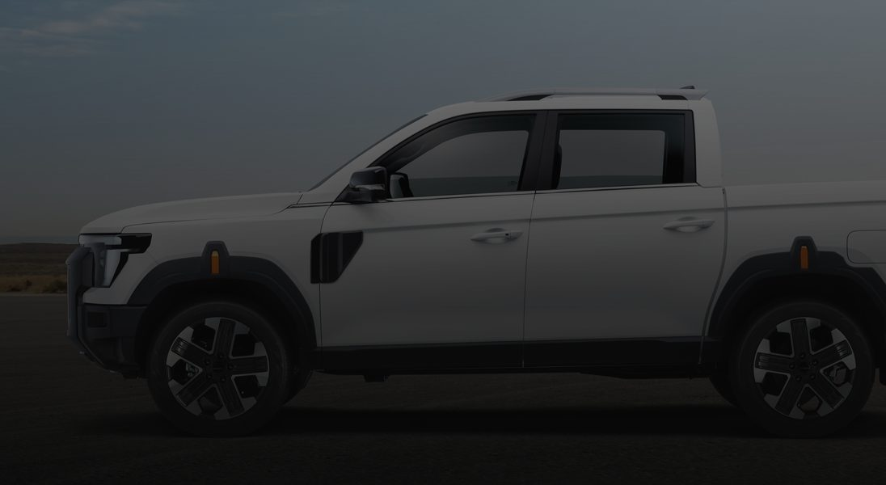
READY BEFORE THE CARS LAND.
Three weeks to a premium bilingual KGM presence that collects leads — and a further 10% off the full website when we build it together.
MARWAN BASSAM · WORX BY GLIMPSE · MARWAN@WORXBYGLIMPSE.COM

